Slide 1
Building chatbots with MS Bot Framework
Anatomy of MS Bot Framework

Slide 2
Components
Activity
Intent Detection
Response

Slide 3
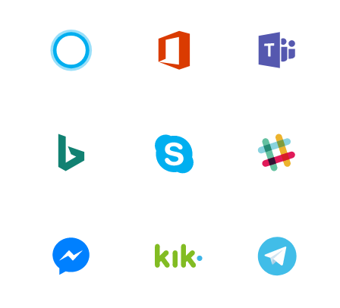

Bot Framework
LUIS.AI
DialogFlow
Your BOT Application

